Slide 1

BCAC 0016 FUNDAMENTALS OF INTERNET PROGRAMMING
Dr. KANTA PRASAD SHARMA ( K P SHARMA)
Assistant Professor,
Computer Engineering & Applications,
GLA University, Mathura

Slide 2
Syllabus

Slide 3
Books
Text Books:
Thomas Powell, ”HTML & CSS: The Complete Reference , Fifth Edition, 2010, McGraw Hill Education India
Reference Books:
Deborah S. Ray, Eric J. Ray , “Mastering HTML 4”, 2nd Ed, Willy India
Steven M. Schafer, “HTML, XHTML, and CSS Bible”, 5ed Wiley India
John Duckett, “Beginning HTML, XHTML, CSS, and JavaScript” , Wiley India
Wendy Willard, HTML: A Beginner's Guide, Fifth Edition 2013, TMH

Slide 4
DHTML: Dynamic Hypertext Markup
DHTML stands for Dynamic Hypertext Markup language i.e., Dynamic HTML.
Dynamic HTML is not a markup or programming language
It is a term that combines the features of various web development technologies for creating the web pages dynamic and interactive.
DHTML application was introduced by Microsoft with the release of the 4th version of IE (Internet Explorer) in 1997.

Slide 5
USES OF DHTML
used for designing the animated and interactive web pages that are developed in real-time.
Helps users by animating the text and images in their documents.
It allows the authors for adding the effects on their pages.
It also allows the page authors for including the drop-down menus or rollover buttons.
This term is also used to create various browser-based action games.
Used to add the ticker on various websites, which needs to refresh their content automatically.

Slide 6
Features
Create the web page dynamically.
Dynamic Style is a feature, that allows the users to alter the font, size, color, and content of a web page.
Facility for using the events, methods, and properties. And, also provides the feature of code reusability.
Feature in browsers for data binding.
Users can easily create dynamic fonts for their web sites or web pages.
Users can easily change the tags and their properties.
The web page functionality is enhanced because the DHTML uses low-bandwidth effect.

Slide 7
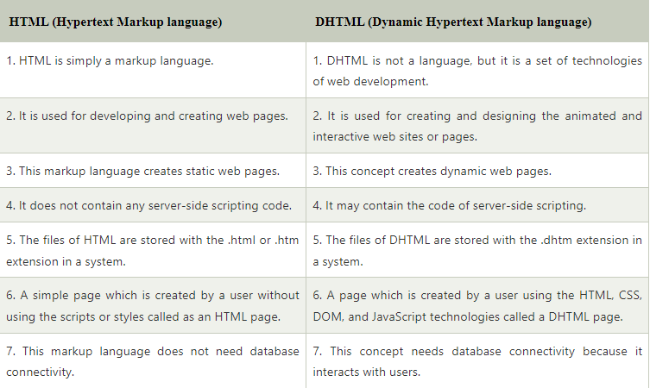
JavaScript
CSS
& DOM
HTML

Slide 8
Introduction JAVA Script
JavaScript can be included in HTML pages.
which creates the content of the page as dynamic.
We can easily type the JavaScript code within the <head> or <body> tag of a HTML page.
If we want to add the external source file of JavaScript, we can easily add using the <src> attribute.
Example : uses of JavaScript technology with the DHTML.

Slide 9
Example
<HTML>
<head>
<title>
Welcome in My JavaScript Class
</title>
</head>
<body>
<script type="text/javascript">
document.write(“GLA University ");
</script>
</body>
</html>
<html> <head>
<title> Welcome in My DHTML with JavaScript </title>
<script type="text/javascript">
function dateandtime()
{
alert(Date());
}
</script>
</head>
<body bgcolor="orange">
<font size="4" color="blue">
<center> <p>
Click here <a href="#" onClick="dateandtime();"> Date and Time </a>
</p> </center>
</font>
</body> </html>

Slide 10
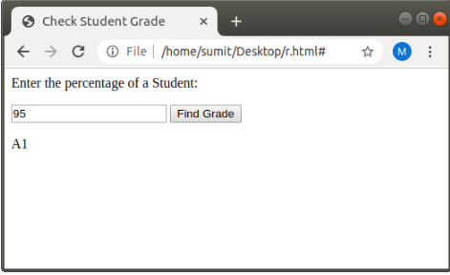
JavaScript and HTML DOM
With version 4 of HTML, JavaScript code can also change the inner content and attributes of the HTML event.
We are checking the Grade of a student according to the percentage criteria with the JavaScript and HTML DOM.
Problem Analysis

Slide 11
Example
<html>
<head> <title> Check Student Grade </title> </head>
<body>
<p>Enter the percentage of a Student:</p>
<input type="text" id="percentage">
<button type="button" onclick="checkGrade()">
Find Grade
</button>
<p id="demo"></p>
<script type="text/javascript">
function checkGrade()
{
var x,p, text;
p = document.getElementById("percentage").value;
x=parseInt(p);
if (x>90 && x <= 100)
{
document.getElementById("demo").innerHTML = "A1";
}
else if (x>80 && x <= 90)
{
document.getElementById("demo").innerHTML = "A2";
}
else if (x>70 && x <= 80)
{
document.getElementById("demo").innerHTML = "A3";
}
}
</script>
</body>
</html>

Slide 12

DHTML CSS
We can easily use the CSS with the DHTML page with the help of JavaScript and HTML DOM.
With the help of this.style.property=new style
we can change the style of the currently used HTML element.
we can also update the style of any particular HTML element by
document.getElementById(id).style.property = new_style .

Slide 13
Example
<html>
<head>
<title> Changes current HTML TEXT Color on the Click</title>
</head>
<body>
<center>
<h1 onclick="this.style.color='blue'"> Welcome in FIP Class</h1>
<center>
</body>
</html>

Slide 14
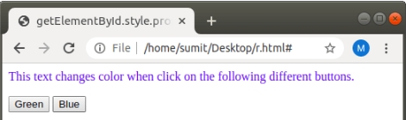
CSS with JavaScript in DHTML
With version 4 of HTML, JavaScript code can also change the style such as size, color, and face of an HTML element.
<html>
<head> <title> </title>
</head>
<body>
<p id="demo"> Let us changes text color when click on the ifferent buttons. </p>
<button onclick="change_Color('green');"> Green </button>
<button onclick="change_Color('blue');"> Blue </button>
<script type="text/javascript">
function change_Color(newColor)
{
var element = document.getElementById('demo').style.color = newColor;
}
</script>
</body>
</html>

Slide 15
DHTML Events
An event is defined as changing the occurrence of an object.
It is compulsory to add the events in the DHTML page.
Without events, there will be no dynamic content on the HTML page.
The event is a term in the HTML,
which triggers the actions in the web browsers.
Suppose, any user clicks an HTML element,
then the JavaScript code associated with that element is executed.
Actually, the event handlers catch the events performed by the user and then execute the code.

Slide 16
Types of Event
Load Image
Button Click
Form Submission
Click a button.
Submitting a form.
An image loading or a web page loading,
onclick
ondblclick
onsubmit
Lets play for onclick event handler,
which is used to change the text after clicking

Slide 17
Example
<html> <head>
<title> Example of onclick event </title>
<script type="text/javascript">
function ChangeText(ctext)
{
ctext.innerHTML=“ GLA WLCOME YOU !! ";
}
</script> </head>
<body>
<font color="red"> Click on the Given text for changing it: <br></font>
<font color="blue">
<h1 onclick="ChangeText(this)"> STAR BNNE K LIYE MEHNAT KRNI PSDTI HE!! </h1>
</font>
</body> </html>

Slide 18
<html> <head> <title> ON SUBMIT EVENT </title> </head>
<body>
<form onsubmit="Submit_Form()">
<label> Enter your name: </label>
<input type="text">
<label> Enter your Roll no: </label>
<input type="Number">
<input type="submit" value="submit">
</form>
<script type="text/javascript">
function Submit_Form()
{
alert(" Your form is submitted");
}
</script> </body> </html>

Slide 19
JAVA SCRIPT VARIABLE
<html>
<body>
<p id="demo"></p>
<script>
var x = 5;
var y = 6;
var z = x + y;
document.getElementById("demo").innerHTML ="The value of z is: " + z;
</script>
</body>
</html>
4 Ways to Declare a JavaScript Variable:
Using var
Using let
Using const
Using nothing
<script>
let x = 5;
let y = 6;
let z = x + y;
document.getElementById("demo").innerHTML ="The value of z is: " + z;
</script>

Slide 20
JavaScript Const
The const keyword was introduced in ES6 (2015).
Variables defined with const cannot be Redeclared.
Variables defined with const cannot be Reassigned.
Variables defined with const have Block Scope.
const PI = 3.14159265359;
May be error
const PI; PI = 3.14159265359;
Use const ??:
A new Array
A new Object
A new Function
A new RegExp

Slide 21
Example
<html>
<body>
<h2>JavaScript const</h2>
<p>Declaring a constant array does NOT make the elements unchangeable:</p>
<p id="demo"></p>
<script>
// Create an Array:
const cars = ["Saab", "Volvo", "BMW"];
cars[0] = "Toyota";
cars.push("Audi");
document.getElementById("demo").innerHTML = cars;
</script>
</body>
</html>

Slide 22
Example
<html>
<body>
<p>Declaring a constant object does NOT make the objects properties unchangeable:</p>
<p id="demo"></p>
<script>
const car = {type:"Fiat", model:"500", color:"white"};
car.color = "red";
// Add a property:
car.owner = “Pranjal";
document.getElementById("demo").innerHTML = "Car owner is " + car.owner;
</script>
</body>
</html>

Slide 23
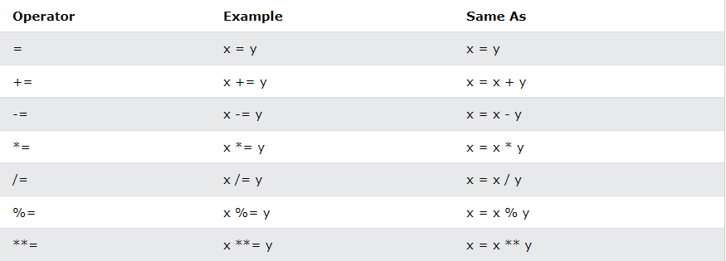
Operators in Java Script

Slide 24
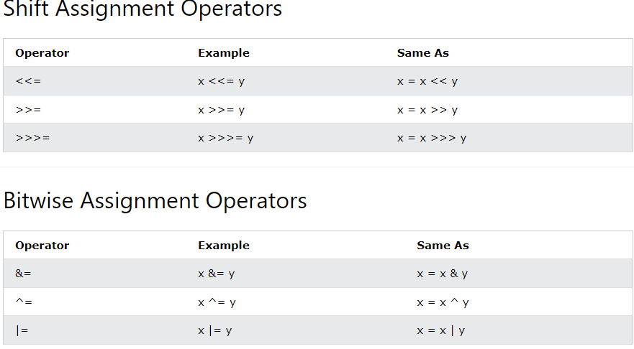

Slide 25
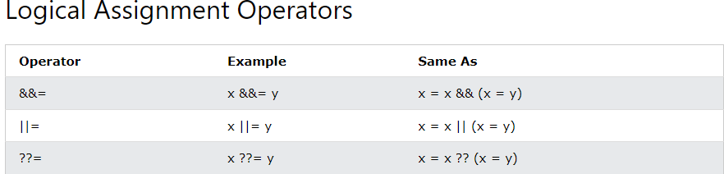
Operators
let x = 10 + y;
let x = 5; let y = 2; let z = x + y;
let x = 5; let y = 2; let z = x * y;
let text = "Hello"; text += " Pranjal";

Slide 26
Function
<!DOCTYPE html>
<html>
<body>
<h2>JavaScript Functions</h2>
<p id="demo"></p>
<script>
function toCelsius(f)
{
return (5/9) * (f-32);
}
document.getElementById("demo").innerHTML = toCelsius;
</script>
</body>
</html>

Slide 27
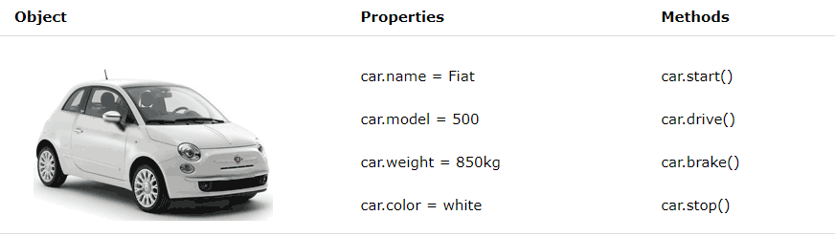

Slide 28
For & While Loop
<!DOCTYPE html>
<html>
<body>
<p id="demo"></p>
<script>
const friend= [“ram", “mohan", “tina", “rahul", “umang", “adi"];
let text = "";
for (let i = 0; i < friend.length; i++)
{
text += friend[i] + "<br>";
}
document.getElementById("demo").innerHTML = text;
</script></body></html>
<html>
<body>
<h2>JavaScript While Loop</h2>
<p id="demo"></p>
<script>
let text = "";
let i = 0;
while (i < 10)
{
text += "<br>The number is " + i;
i++;
}
document.getElementById("demo").innerHTML = text;
</script>
</body>
</html>

